Slide 1
Behavioral Anomaly Detection
for Identity Threat Detection
An Unsupervised Machine Learning Approach to MITRE ATT&CK T1078
Benjamin Brady
June 2026
Python · scikit-learn · pandas · Isolation Forest
Notes:
Open with: This project implements a behavioral anomaly detection pipeline targeting credential compromise — specifically MITRE ATT&CK T1078, Valid Accounts. It is unsupervised — no labeled attack data required. I built this to demonstrate applied ML thinking in the identity security space.

Slide 2
The Problem: Credential Compromise is Invisible to Perimeter Defenses
MITRE ATT&CK T1078
Zero Trust Gap
The Detection Problem
Valid Accounts — adversaries use legitimate stolen credentials to authenticate as authorized users. Traditional controls see a valid login.
Perimeter-based models trust anything inside the network. A compromised VPN credential = full internal access under legacy architecture.
You cannot label every attack variant in advance. You need to model what 'normal' looks like — and flag everything that deviates.
Source: MITRE ATT&CK T1078 | NIST SP 800-207
Notes:
T1078 is one of the most frequently observed techniques across real-world breaches. It succeeds in 98% of tested environments per Picus Blue Report 2025. The reason: if you trust network location, a valid credential from an attacker looks identical to a valid credential from the real user. You need behavioral signals.

Slide 3
Approach: Model Normal, Flag Deviations
Isolation Forest — Liu, Ting & Zhou (IEEE 2008)
1
Random Partitioning
2
Isolation Principle
Build an ensemble of 100 random decision trees. At each node, randomly select a feature and a split value.
Anomalies sit in sparse feature space regions. Fewer random splits are needed to isolate them from the rest of the data.
3
Anomaly Score
4
Why It Fits
Score = average path length to isolation across all trees. Shorter path = more anomalous. No labeled data required.
No distributional assumption. Linear time complexity O(n). Scales to high-throughput authentication telemetry.
Notes:
The key insight of Isolation Forest: you don't need to know what attacks look like. You need to know what normal looks like — and normal is easy to learn because it's the majority. Anomalies isolate themselves because they're few and different. This is why it works without labels.

Slide 4
Dataset & Feature Engineering
Synthetic Dataset
Engineered Features
Total Events
3,074
typing_speed_wpm
Behavioral biometric — scripted access shows abnormal cadence
Normal Logins
3,000
click_through_rate
Session navigation pattern — bots near 0.0 or 1.0
Injected Anomalies
74 (2.41%)
login_hour
Temporal signal — 1–4 AM outside user baseline
Users
50
hours_since_last_login
Time delta — impossibly short for trans-continental travel
Time Span
~2 months
distance_from_last_login
Haversine great-circle distance from prior login (km)
Anomaly Types
velocity_kmh
Impossible Travel
30
Derived: distance / time — values >1,200 km/h physically impossible
Typing Speed
18
Click-Through
15
Session Timing
11
Notes:
The velocity feature is the key engineering decision. Impossible travel — someone logging in from New York then Beijing 10 minutes later — shows up as 40,000+ km/h. I derived this from the raw lat/lon and timestamp data using the Haversine formula, which I imported from the data generation module rather than duplicating it. That's the DRY principle applied.

Slide 5
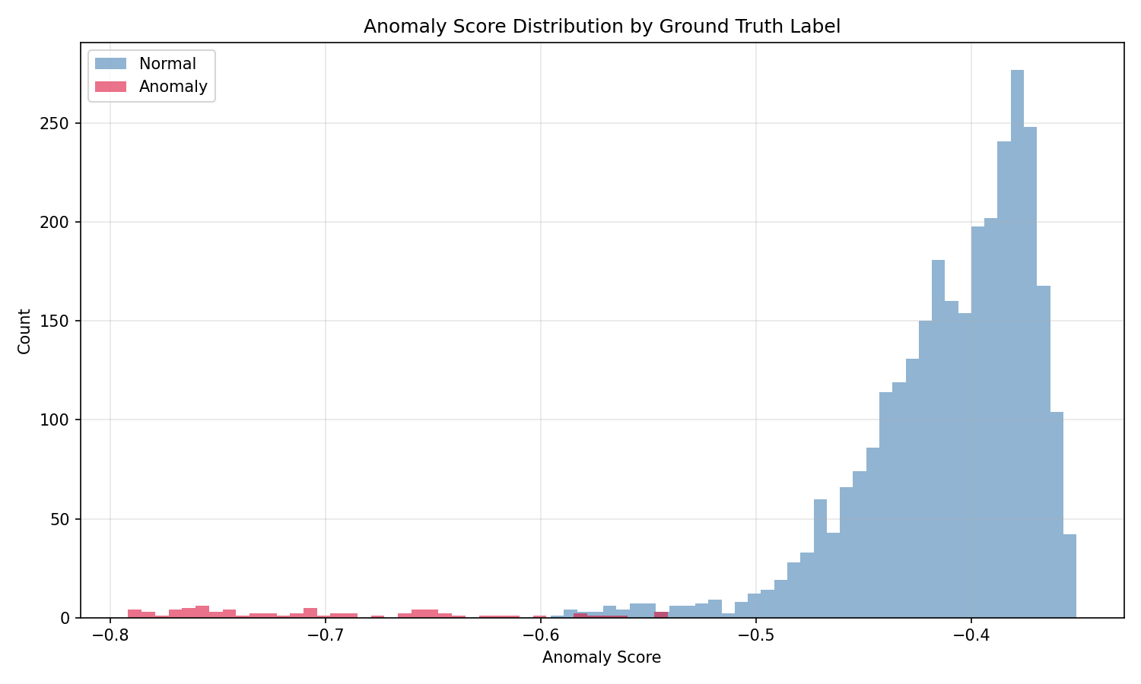
Results: Anomaly Score Distribution
Normal Events
Score −0.40 to −0.55. Dense cluster — many splits to isolate.
Anomalous Events
Score below −0.60. Fewer splits needed due to sparse feature space.
Impossible Travel
Scores approaching −0.79 — most extreme outliers in the dataset.
Overlap Region
6 false negatives and 9 false positives occur at the distribution boundary.
sklearn IsolationForest.score_samples() — raw values, more negative = more anomalous
Notes:
The distribution separation is the visual proof the model learned something real. If these distributions overlapped completely, the model would be guessing. The clear left-shift of the anomaly distribution confirms the feature engineering captured meaningful signal.

Slide 6
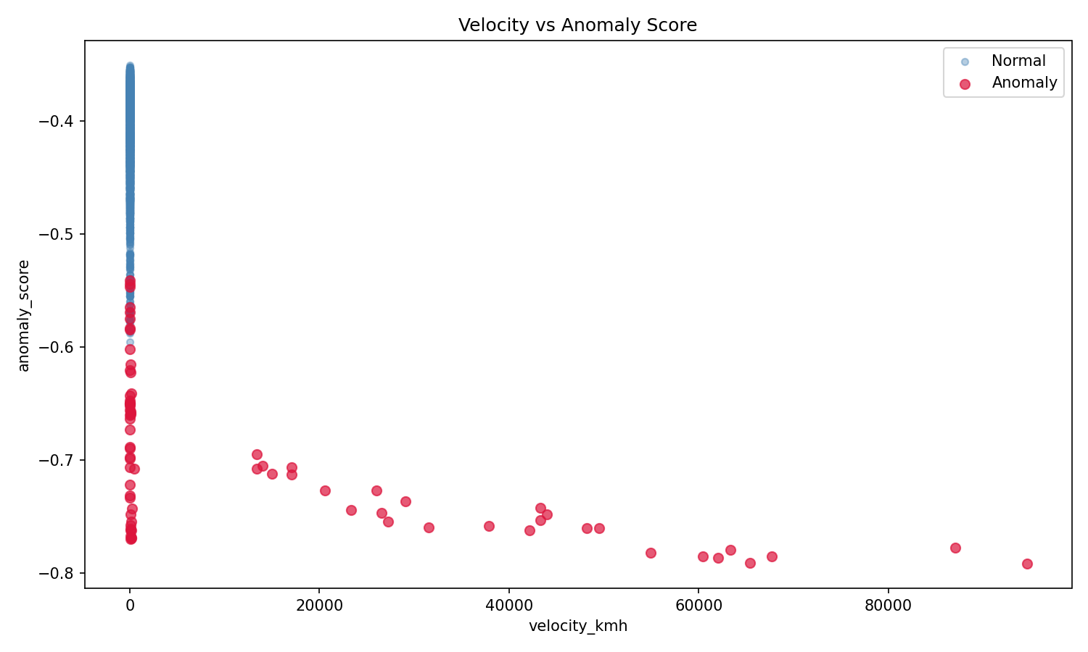
Results: Velocity vs. Anomaly Score
Reading the Plot
Blue (Normal)
Low velocity, score −0.40 to −0.55
Orange (Anomaly)
Left cluster: behavioral anomalies, same location. Right spread: impossible travel
Key Insight
Behavioral signals catch attackers even when location is masked by VPN/proxy
94,578 km/h
Most extreme impossible travel — New York to Beijing in 8 minutes
Notes:
The orange cluster at velocity near zero is the most important part of this chart. Those are the behavioral anomalies — typing speed, click-through, session timing. The attacker is logging in from the right city, at the right time — but their behavior is wrong. A production ZTNA system that only checked location would miss these. Multi-signal detection catches them.

Slide 7
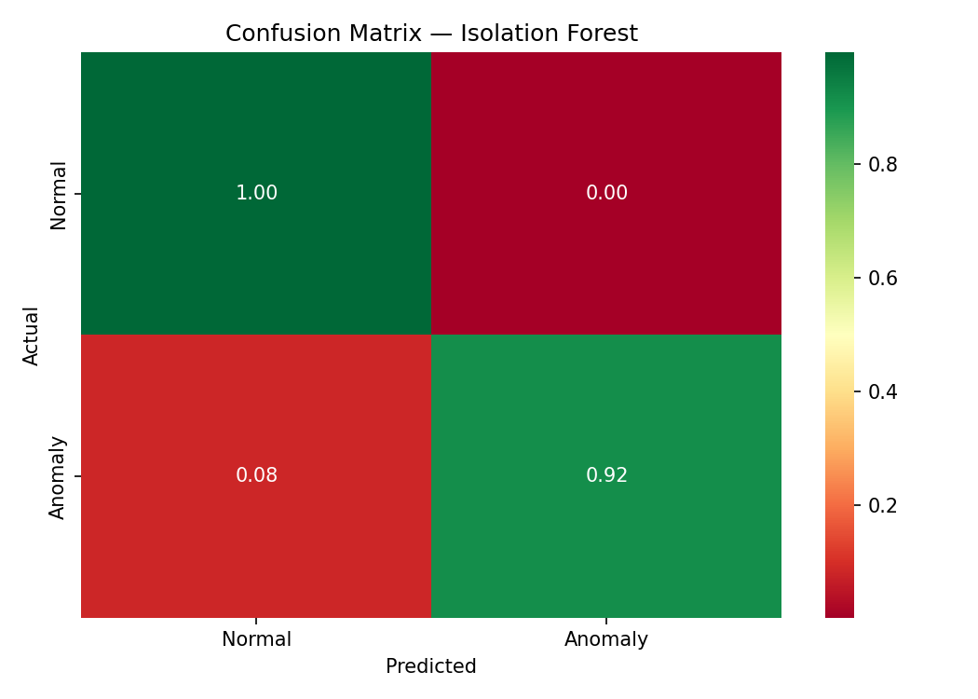
Results: Classification Performance
92%
Recall
68 of 74 anomalies caught
88%
Precision
9 false positives from 3,000 normal
0.90
F1 Score
Harmonic mean of precision & recall
In security, recall is the primary target: a missed attack has greater consequence than a false alarm.
Notes:
92% recall means we catch 92 out of every 100 real attacks with no labeled training data. The 6 misses are behavioral anomalies where the signal was subtle — typing speed or CTR only slightly outside normal range. A production system would tune contamination per user rather than using a population-level threshold.

Slide 8
Limitations & Production Considerations
01
02
03
Synthetic Data
Population-Level Baseline
Static Contamination
Real telemetry has correlated noise, irregular patterns, and shared devices. Performance requires empirical re-evaluation on production data.
A production system must maintain per-user behavioral baselines. A 3 AM login is anomalous for most users but normal for an overnight analyst.
The contamination parameter was set using known dataset properties. In production, the true anomaly rate is unknown and requires adaptive estimation.
04
05
No Temporal Modeling
Feature Set Scope
Isolation Forest treats each event independently. Production systems incorporate session-level sequences and behavioral drift over time.
Six features modeled here are a subset. Production telemetry includes device fingerprinting, network characteristics, and IdP risk signals.
Notes:
The limitations section is intentional and important. Knowing what your model doesn't do is as valuable as knowing what it does. A production deployment would address all five of these — but this proof-of-concept demonstrates the core detection logic and the viability of the unsupervised approach.

Slide 9
Relevance to Identity Security & ZTNA
Prior Work: HCL Anomaly Detection Pipeline
At HCL I built and maintained the data pipeline feeding an anomaly detection and remediation system — impossible travel, typing speed, and click-through behavioral signals — integrating SharePoint and SQL Server sources into BigFix via API. I owned the PMO that was the intake point for all signal data. This project extends that experience into a fully instrumented ML pipeline.
T1078 Connection
The four detection signals modeled here map directly to MITRE ATT&CK T1078 detection indicators: impossible travel (geolocation anomaly), typing speed (behavioral biometric), click-through rate (session behavioral pattern), and session timing (temporal baseline deviation). These are the same signals a ZTNA risk engine evaluates for continuous access decisions.
Data Engineering Foundation
The detection pipeline requires reliable, clean data. Feature engineering (velocity derivation, sequential shift operations, NaN imputation strategy) reflects the data engineering discipline that underpins any production ML system. The pipeline architecture — ingestion, feature engineering, model inference, output persistence — mirrors the structure of a production detection engine.
Notes:
This slide ties the technical work back to the role. The HCL pipeline story is real — I built that. This project is the next step: taking that experience and building a fully instrumented, evaluated ML pipeline around the same detection concepts.

Slide 10
92% Recall. Zero Labeled Training Data.
Unsupervised behavioral anomaly detection for identity-based threats.
Benjamin Brady
github.com/BenBrady1/behavioral-anomaly-detection
Ben.Brady1989@gmail.com
References: Liu et al. (2008) IEEE · MITRE ATT&CK T1078 · NIST SP 800-207 · Chandola et al. (2009) ACM
Python · scikit-learn · pandas · matplotlib · seaborn
Notes:
Close with: The headline number is 92% recall with no labeled attack data. The model learns what normal looks like and flags everything that isn't. That's the unsupervised advantage — you don't need to have seen the attack before to detect it.

